Slide 1
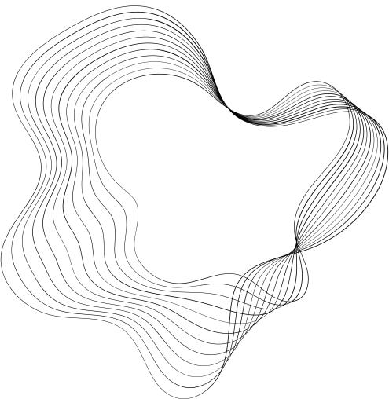

INTELLIGENT DATA ANALYTICS
PREDICTING HOSPITAL READMISSIONS
HTTPS://WWW.KAGGLE.COM/COMPETITIONS/2023-IDA-CLASSIFICATION-CHALLENGE/LEADERBOARD

Slide 2
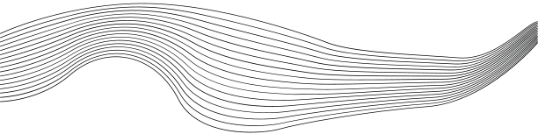
CONTENT
01
PROBLEM STATEMENT
02
GOALS AND OBJECTIVES
03
DATA REPORTS
04
DATA PREPARATION
05
FEATURE SELECTION
06
SUMMARY OF MODEL PERFORMANCE
07
MODEL EVALUATION
08
KAGGLE SCORE

Slide 3
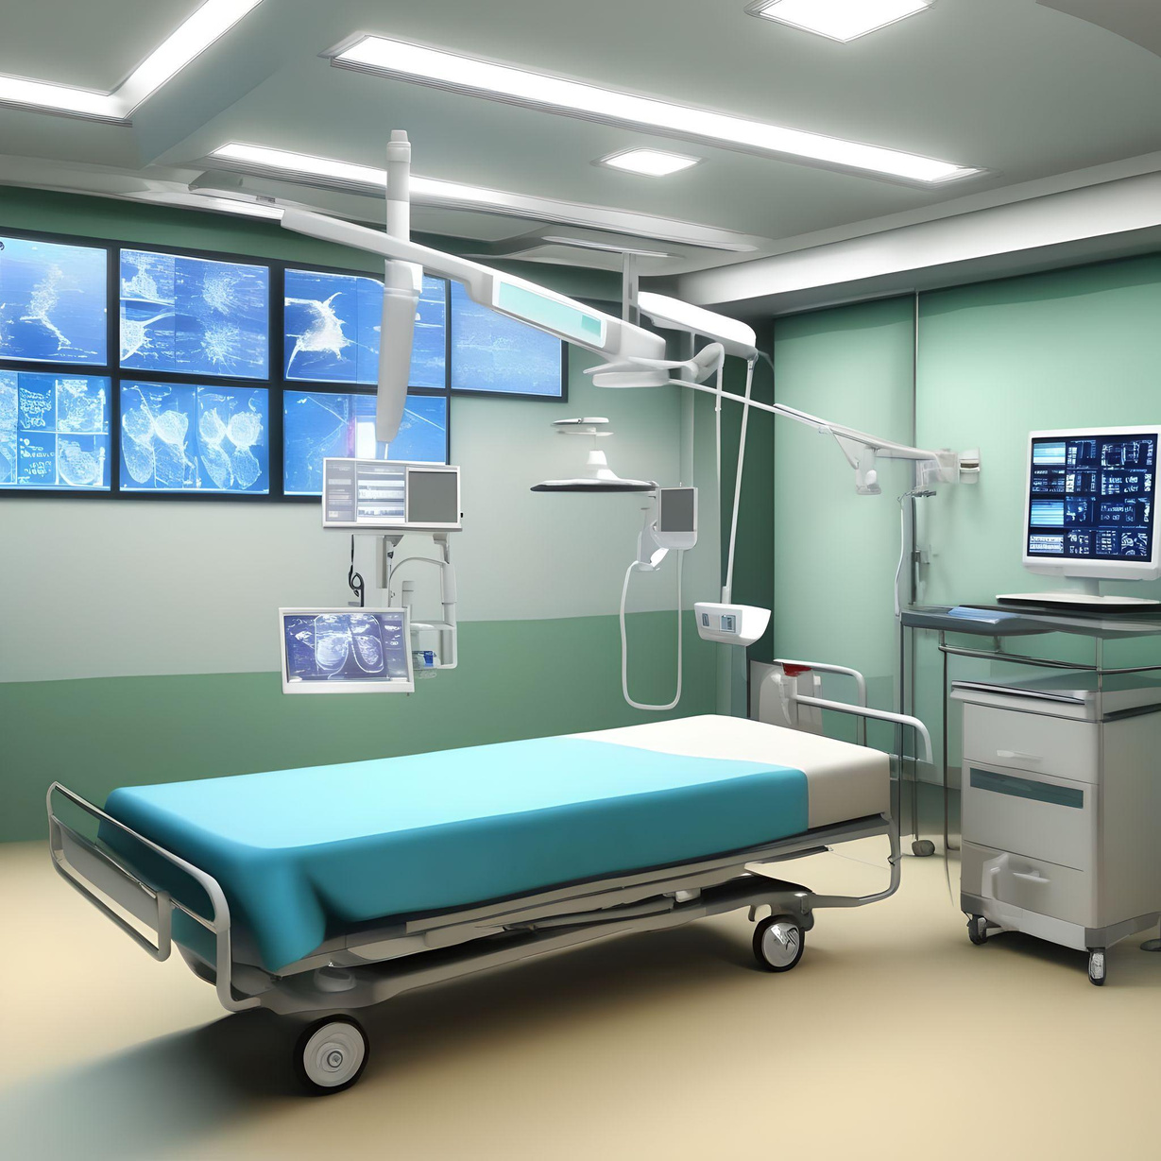



PROBLEM STATEMENT
Readmission rates have increasingly been used as an outcome measure in health services research and as a quality benchmark for health systems. Hospital readmission rates were formally included in reimbursement decisions for the Centers for Medicare and Medicaid Services (CMS) as part of the Patient Protection and Affordable Care Act (ACA) of 2010, which penalizes health systems with higher than expected readmission rates through the Hospital Readmission Reduction Program
In this machine learning problem, we have tried to predict whether or not a patient will be readmitted to the hospital based on the extensive past medical data of the patients which comes from multiple hospitals across the United States for several years.Link for the Dataset is as follows:
https://shorturl.at/cirzD

Slide 4





GOALS AND OBJECTIVES
Initial Data Analysis
Data Preprocessing
Bulding Models to Predict
Generating a Data Quality Report of the dataset to determine various parameters like missing value percentage, modes of discrete columns and number of Factor levels
Performing Data Preparation through
missing value imputation and factor level collapsing
Build over 5 classification models and summarize their performance in a table and choose the best performing model on the basis of their performance metrics, to do the final predictions on Test dataset

Slide 5

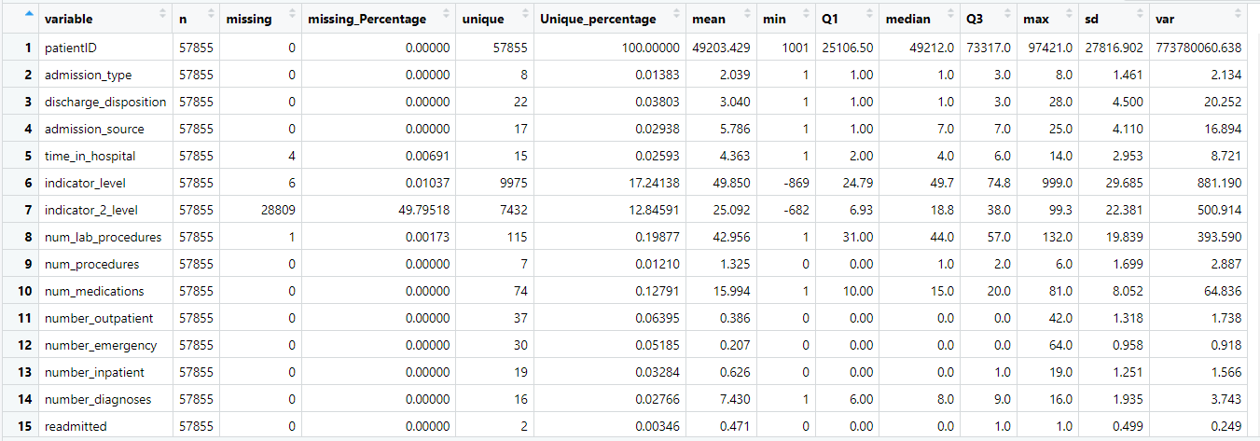
DATA REPORT FOR NUMERIC COLUMNS
From the above quality report we can see we have in total of 15 columns for numeric data.
The report tells you about various statistical parameters for each variable like mean, max, quartiles, standard deviation and variance,in order to get more clarity on the overall data quality.
We have a few columns with missing data, especially the indicator_2_level variable which has 49.795 % missing Data, which we’ll need to deal with.

Slide 6
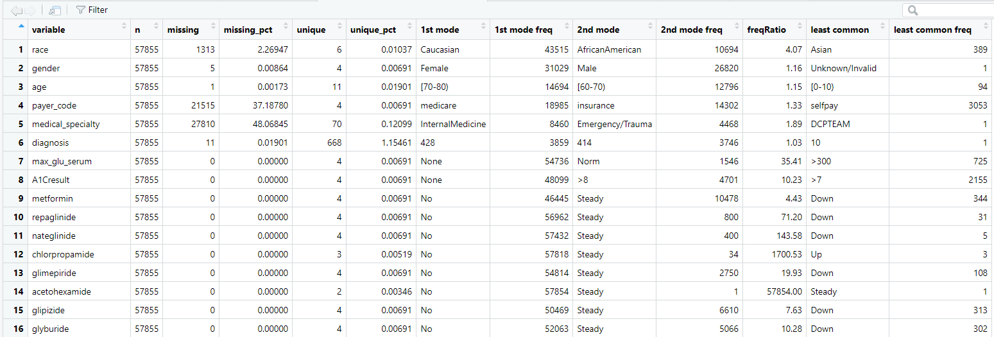
DATA REPORT FOR DISCRETE COLUMNS(1ST 16 COLUMNS)
We have a total of 32 Discrete columns
Variable ‘payer_code’ and ‘medical_speciality’ have a huge number of missing values which we needed to deal with.
There are a few columns like ‘Diagnosis’ and ‘medical_speciality’ which have a lot of factor levels which we have tried to collapse.

Slide 7
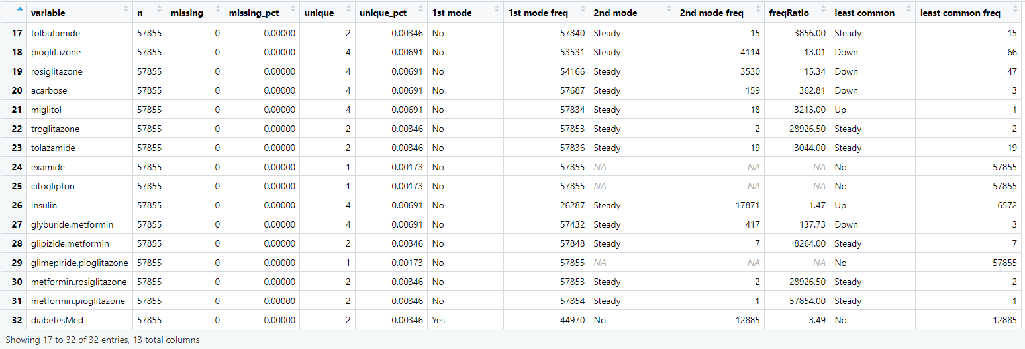
DATA REPORT FOR DISCRETE COLUMNS(NEXT 16 COLUMNS)
Some of the variables, have 0 variance, which means they have only 1 value for all the observations.
I decided to remove these variables as they do not contribute any information to the model as they have no variability, and including them may lead to issues such as multicollinearity.

Slide 8

Data Preparation
01
02
03
04
REMOVING MISSING VALUES IN NUMERIC COLUMNS
REMOVING MISSING VALUES IN DISCRETE COLUMNS
FACTOR LEVELS COLLAPSING
REMOVING COLUMNS WITH ZERO VARIANCE
We used Predictive mean matching due to its ability to preserve relationships between variables and produce more realistic imputations that are within the range of observed values.
First performed conversion of all character columns to factor types.We used mode imputation for Variables where the percentage of missing values is less than 10%. For any column with a lot of missing values we decided to convert, the NA values to another level of Category
We used FCT_lump_n in the forcats package which is a handy function that allows you to group together less frequent levels of a factor into a single level..
They do not contribute any information to the model as they have no variability, and including them may lead to issues such as multicollinearity.

Slide 9
FEATURE SELECTION
We performed a backward stepwise logistic Regression to exclude unimportant features one by one
Removed the identifier variable patient ID
Included all other variables as the p values were less and the accuracy score would drop after excluding any more variables

Slide 10
LIST OF MODELS IMPLEMENTED
01
LOGISTIC REGRESSION
02
RANDOM FOREST
03
M.A.R.S.
04
DECISION TREE
05
XG BOOST

Slide 11
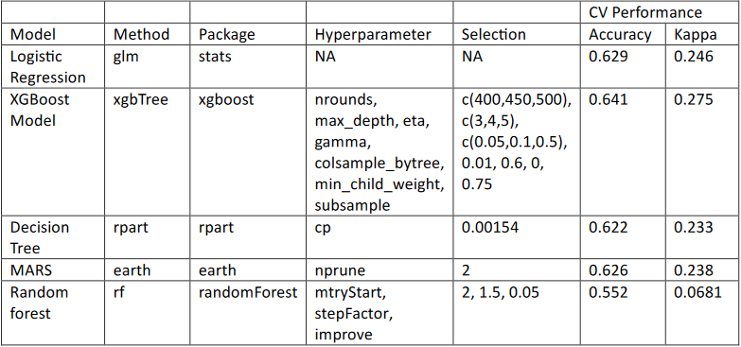
MODEL PERFORMANCE SUMMARY
The below table shows the various model performance summarizations(accuracy, kappa value)
We choose Xgboost to be our preferred model as it had the highest accuracy among all

Slide 12

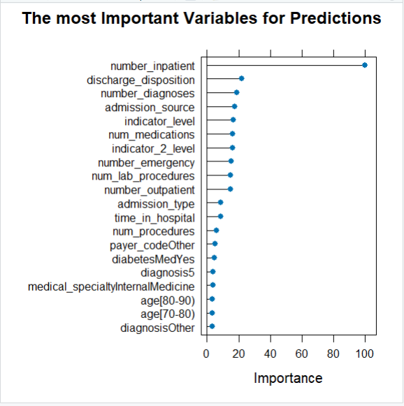
XG BOOST MODEL
The performance of the XGBoost is far better than compared with the others.
The processing Time was a bit long considering the Dataset size and number of variables
We got an accuracy value of 0.641 and kappa value of 0.275
The graph describes the most important features which drove the prediction model.
We’ll discuss about the insights in next class

Slide 13
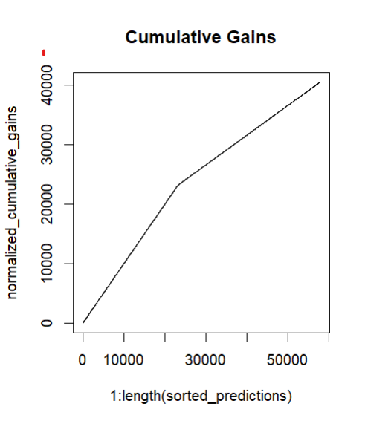
MODEL PERFORMANCE METRICS
We got the following metrics from, the confusion Matrix Function for the model
Accuracy : 0.667
95% CI : (0.6632, 0.6709)
No Information Rate : 0.5295
P-Value [Acc > NIR] : < 2.2e-16
Kappa : 0.3262
Mcnemar's Test P-Value : < 2.2e-16
Sensitivity : 0.7506
Specificity : 0.5729
Pos Pred Value : 0.6642
Neg Pred Value : 0.6712
Precision : 0.6642
Recall : 0.7506
F1 : 0.7048
Prevalence : 0.5295
Detection Rate : 0.3974
Detection Prevalence : 0.5984
Balanced Accuracy : 0.6618
Positive' Class : No
Log loss : 0.6062757
Cumulative Gain is a
Cumulative Gain is a metric used to evaluate the effectiveness of a model or a ranking system in capturing
the relevant instances or outcomes.
From the plot, we can observe that it is an increasing graph which indicates that the model's
ranked predictions are capturing relevant instances effectively as you move through the ranked the effectiveness of a model or a ranking system in capturing
the relevant instances or outcomes,

Slide 14
POTENTIAL INSIGHTS FOR THE
HOSPITALS BASED ON MODEL:
The feature "Number of inpatient visits" represents the count of hospital inpatient visits that the patient experienced in the year preceding the current healthcare encounter.
The graph suggests highest positive correlation between the number of inpatient visits and the likelihood of patient readmission.
Hospitals and healthcare providers should pay attention to patients with a history of multiple inpatient visits.
Implementing strategies to improve care transitions and post-discharge follow-ups for frequent inpatient visitors could be beneficial.
CUSTOMERS

Slide 15
OTHER IMPORTANT INSIGHTS:
"Discharge disposition" refers to the location or status to which a patient is discharged after receiving medical care in a hospital.
By analyzing the disposition data of the patients, we can tailor interventions and post-discharge care plans based on the specific needs associated with different discharge scenarios, ultimately contributing to improved patient outcomes and reduced readmission rates
The "Number of diagnoses" variable represents the count of diagnoses that have been entered into the healthcare system for a particular patient.
Analyzing this data alongside other predictors allows for a holistic assessment of the patient's health, contributing to more targeted and effective healthcare interventions.
CUSTOMERS

Slide 16
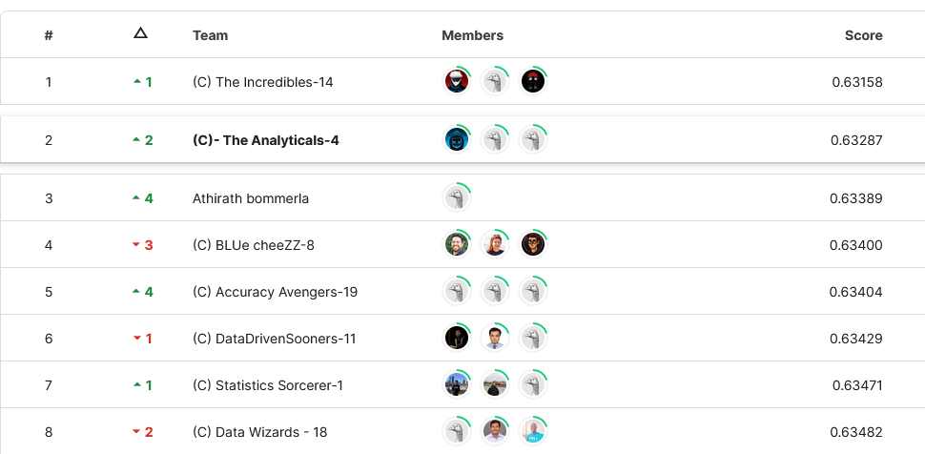
KAGGLE COMPETION SCORE
Our team managed to get a 2nd rank among the
32 teams participating in the competition
Our RMSE score was 0.63287
2ND RANK

Slide 17

THANK YOU

